Slide 1
Ecommerce Database
Project 1: SQL

Slide 2
Problem Statement
Find answers to the following questions from the database Ecommerce
1. Highest level of transaction revenue (which cities and countries).
2. Average products ordered (per city and country).
3. Pattern in the categories of products ordered (per city and country).
4. Top selling product (per city and country).
5. Impact of revenue (per city and country).
Provided some additional information base on the database

Slide 3
Resources and Risks
The information available for the analysis is distributed in the following five table.
1. all_sessions
2. analytics
3. products
4. sales_report
5. sales_by-sku
Risks:
Assumptions on the data were made with out the option to contact the database creator.

Slide 4
Assumptions:
Questions 1 to 5 will be base on the Sales Report and/or information where city and country are available in the database
There is one unique SKU for every single product
“SKU” and “product SKU” are the same fields
The information from “products ordered” or “orderedQuantity” refers to the products order by the visitors
Total transaction revenues is not the result of (product quantity * product price)
“Total transaction revenue” and “transaction revenue” refers to the same
Information in table “sales by SKU” can be found in table “sales_report”

Slide 5
Process
Profiling
Validating and Cleaning
Documenting
Understanding request
Understanding data
Finding relations
Identify irrelevant or
redundant data
Identify duplicates
Check data types
Handle missing data

Slide 6
Solutions
Question 1: Highest level of transaction revenue (per All_sessions table)
Country – United States
City – Atlanta
Question 2: Average products ordered from visitors per country and city (top 3)
Top 3
Brano, Czechia
Riyadh, Saudi Arabia
Rexburg, United States
From 454 different products and 5518 orders the average products ordered overall is 12

Slide 7
Solutions ..continuation
Question 3 and 4: Pattern in product categories of products ordered per country and city and Top selling product per country and city
More analysis or data is required to define potential pattern by city
The current information shows that : The product ordered the most is "Ballpoint LED Light Pen“ from Home/Office category
United States and Germany have the most visitors for this product
Question 5: Summarize the impact of revenue per country and city

Slide 8
Solutions ..continuation
Question 5: Impact of revenue (per city and country)
From all totaltransactions available where the country and city is define:
86% of the total transactions revenue is from United States
14% of the total transactions revenue is from Israel, Australia, Canada and Switzerland
The top contributing cities from United States are Sunnyvale, Atlanta and San Francisco
The top contributing cities for the 14% are Tel Aviv-Yafo, Sydney, Toronto and Zurich

Slide 9
Solutions ..continuation
Additional Information:
There are 454 products available with a total of 5519 orders (per Sales_Report )
304 products have orders
150 products have no orders at all
StockLevel vs Restocking LeadTime
The majority of the stock Levels are higher than RestockingLead Time,
Products that does not meet the previous statement have a total_ordered of 10 or less

Slide 10
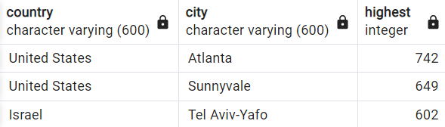
Question 1. Query
SELECT country, city, "totalTransactionRevenue" FROM all_sessions
WHERE "totalTransactionRevenue" IS NOT NULL and country != 'NULL' and city != 'NULL'
ORDER BY "totalTransactionRevenue" DESC, country, city
LIMIT 3

Slide 11
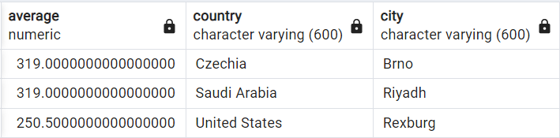
Question 2. Query 1 of 2
SELECT AVG(total_ordered)average, als.country, als.city
FROM sales_report
JOIN all_sessions als
ON als."SKU" = sales_report."SKU"
WHERE country != 'NULL' and city != 'NULL'
GROUP BY als.country, als. city
ORDER BY average DESC, als.country, als.city,

Slide 12

Question 2. Query 2 of 2
SELECT AVG(total_ordered)average,
FROM sales_report
ORDER BY average DESC

Slide 13
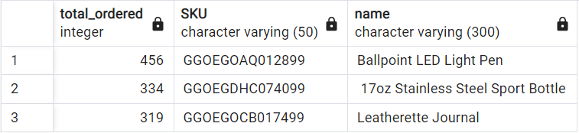
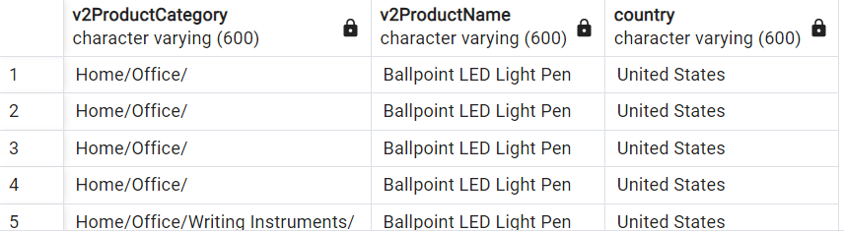
Question 3 and 4. Query 1of 2
SELECT sr.total_ordered, sr."SKU", sr."name" FROM sales_report sr
ORDER BY total_ordered DESC
LIMIT 3
SELECT "v2ProductCategory", "v2ProductName", country FROM all_sessions
where "v2ProductName" = 'Ballpoint LED Light Pen'

Slide 14
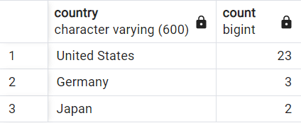
Question 3 and 4. Query 2of 2
SELECT country, COUNT("fullVisitorId") FROM all_sessions
where "v2ProductName" = 'Ballpoint LED Light Pen'
GROUP BY country
HAVING COUNT("fullVisitorId")>0
ORDER BY COUNT("fullVisitorId")DESC

Slide 15
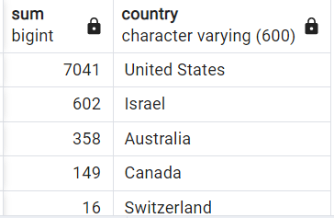
Question 5. Query 1 of 2
SELECT SUM("totalTransactionRevenue"), country FROM all_sessions
WHERE city != 'NULL' and country != 'NULL'
and "totalTransactionRevenue" IS NOT NULL
GROUP BY country
ORDER BY SUM("totalTransactionRevenue") DESC

Slide 16
Question 5. Query 2 of 2
SELECT SUM("totalTransactionRevenue"), country, city FROM all_sessions
WHERE city != 'NULL' and country != 'NULL'
and "totalTransactionRevenue" IS NOT NULL
GROUP BY country, city
ORDER BY SUM("totalTransactionRevenue") DESC

Slide 17


Additional Information Queries
SELECT COUNT("SKU")as no_orders FROM sales_report
where total_ordered = 0
SELECT COUNT("SKU")as with_orders FROM sales_report
where total_ordered > 0

Slide 18
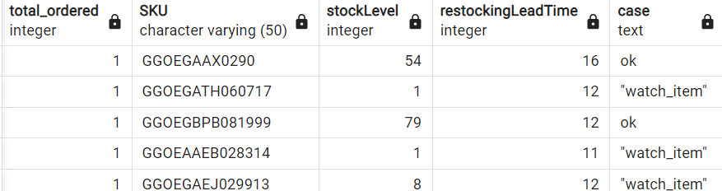
Additional Information Queries
SELECT total_ordered, "SKU", "stockLevel", "restockingLeadTime" ,
CASE
when "stockLevel" < "restockingLeadTime" then '"watch_item"'
else 'ok'
END
FROM sales_report
where total_ordered > 0
ORDER BY total_ordered ASC

Slide 19
Data Cleaning: Queries
ALTER TABLE all_sessions
ALTER COLUMN "fullVisitorId" TYPE numeric USING "fullVisitorId" :: numeric;
ALTER TABLE analytics
ALTER COLUMN "fullvisitorId" TYPE numeric USING "fullvisitorId" :: numeric;
ALTER TABLE all_sessions
ALTER COLUMN "totalTransactionRevenue" TYPE INTEGER USING "totalTransactionRevenue" :: integer;

Slide 20
Cleaning Data…continuation
ALTER TABLE analytics
ALTER COLUMN "units_sold" TYPE integer USING "units_sold" :: integer;
ALTER TABLE analytics
ALTER COLUMN "unit_price" TYPE integer USING "unit_price" :: integer;
ALTER TABLE analytics
ALTER COLUMN "revenue" TYPE numeric USING "revenue" :: numeric;

Slide 21
Cleaning Data…continuation
SELECT unit_price, DIV(unit_price, 1000000)as test
FROM analytics
UPDATE analytics
SET unit_price = (DIV(unit_price, 1000000))
UPDATE all_sessions
SET "totalTransactionRevenue" = DIV("totalTransactionRevenue", 1000000)

Slide 22
Cleaning Data…continuation
UPDATE all_sessions
SET country ='NULL'
WHERE country = '(not set)’
UPDATE all_sessions
SET city ='NULL'
WHERE city = '(not set)' or city = 'not available in demo dataset’
UPDATE all_sessions
SET "v2ProductCategory" ='NULL'
WHERE "v2ProductCategory" ='(not set)'

Slide 23
Distinct
-- Result: 454 distinct count
SELECT COUNT(DISTINCT "SKU") FROM sales_report
-- Result: 454 total count
SELECT COUNT("SKU") FROM sales_report
--Count: 1092
SELECT COUNT(DISTINCT "SKU")FROM products
---Count: 1092
SELECT COUNT("SKU")FROM products

Slide 24
QA testing
Understanding the accuracy and completeness of the data, verifying data types are compatible with each other, understanding the relations between tables
Unit Test Examples
--count in both tables is 5511 SKU
SELECT COUNT(p."SKU"), COUNT(als."SKU") FROM products p
JOIN all_sessions als
ON als."SKU" = p."SKU"
WHERE als.city != 'NULL' and als.country != 'NULL’
Comparing counts with the data source files
Random searching of values

Slide 25
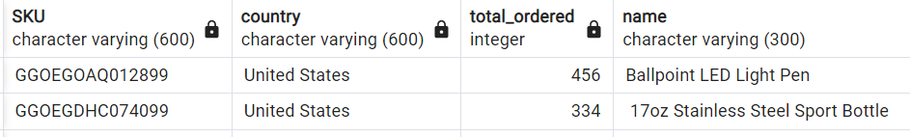
QA testing Query Example
SELECT DISTINCT als."SKU", als.country, sr.total_ordered, sr.name from all_sessions als
JOIN sales_report sr
ON als."SKU" = sr."SKU"
WHERE country != 'NULL' and city != 'NULL' and country = 'United States'
ORDER BY als.country, total_ordered DESC

Slide 26
Conclusion
Request information was answer base on the assumptions about the current database
More accurate analysis could be done understanding the assumptions of the database original creator

